Slide 1
HKN CS61A Final Review
Spring 2019
Rehan Durrani
Danny Chu
Sean O’Brien

Slide 2

Hello!
Eta Kappa Nu (hkn.eecs.berkeley.edu)
Offices at 290 Cory & 345 Soda
Exam Archives, Course Guides & Surveys
Tutoring During Office Hours (12-4 M-F during dead week!)
DISCLAIMER: This is an unofficial review session and HKN is not affiliated with this course. All of the topics we are reviewing will reflect the material you have covered, our experiences in CS 61A, and past exams. We make no promise that what we cover will necessarily reflect the content of the final.
This is licensed under the Creative Commons CC BY-SA: feel free to share and edit, as long as you credit us and keep the license. For more information, visit https://creativecommons.org/licenses/by-sa/4.0/deed.en_US

Slide 3
Agenda
SQL
Scheme
Iterators/Generators
Streams
Macros
Trees
Linked-Lists
Orders of growth
Object-oriented programming
Environment diagrams
This is not necessarily an exhaustive list of things to study! Check out the official details on Piazza and on cs61a.org
Notes:
SQL - Rehan
Scheme - Sean
Iterators/Generators - Sean
Streams - Rehan
Macros - Sean
Trees - Rehan
Linked-Lists - Rehan
Orders of growth - Anthony
Object-oriented programming - Anthony
Environment diagrams - Anthony

Slide 4
Structured Query Language

Slide 5
SQL
Declarative Language based on table and rows
Aggregation through group by and special functions
Limited recursion possible using with

Slide 6
SQL Queries
Queries: SELECT [columns] FROM [tables] WHERE [condition] ORDER BY [attributes] LIMIT [limit];
FROM: tells SQL which tables to select values from, use * for all columns
WHERE: filters by some conditions, boolean expressions
ORDER BY: enforces an ordering by some attribute or attributes (usually a column or columns), ASC for ascending and DESC for descending
LIMIT: limits the number of rows in the output table
Aliases: SELECT a.name AS student1, b.name AS student b FROM students AS a, students AS b WHERE a.name > b.name;
Distinguishes tables with the same name /column names when selecting from them
Renaming columns
Source: Fa17 Lab 12

Slide 7
Order of Operations
FROM - joining tables
WHERE - filtering individual rows
GROUP BY - forming groups
(aggregations) - calculating MAX, AVG, etc. expressions
HAVING - filtering groups (requires GROUP BY)
SELECT - selecting specific columns
DISTINCT - removing duplicate rows
ORDER BY - ordering
LIMIT - limiting number of rows

Slide 8
SQL
create table attacks as
select "Warbot" as name, 1 as attack union
select "Puddlestomper", 3 union
select "Blingtron 3000", 3 union
select "Annoy-o-tron", 1 union
select "Jeeves", 1 union
select "Madder Bomber", 5 union
select "Piloted Shredder", 4;
create table costs as
select "Warbot" as name, 1 as cost union
select "Puddlestomper", 2 union
select "Blingtron 3000", 5 union
select "Annoy-o-tron", 1 union
select "Jeeves", 3 union
select "Madder Bomber", 5 union
select "Piloted Shredder", 4;
create table armors as
select "Warbot" as name, 3 as armor union
select "Puddlestomper", 2 union
select "Blingtron 3000", 4 union
select "Annoy-o-tron", 2 union
select "Jeeves", 4 union
select "Madder Bomber", 4 union
select "Piloted Shredder", 3;
#1: Write a SQL query to create a new table called cards that contains columns for the card name, cost, attack, and armor.
#2: Write a SQL query to get all of the cards whose attack is less than 4 and whose armor is greater than 2, in ascending order of cost. (Hint: use #1)
Notes:
https://kripken.github.io/sql.js/GUI/

Slide 9
SQL
#1: Write a SQL statement to create a new table called cards that combines all 3 tables.
sqlite> create table cards as
select costs.name, cost, attack, armor from costs, attacks, armors
where costs.name = attacks.name and attacks.name = armors.name;
The table looks something like this:
create table cards as
select "Warbot" as name, 1 as cost, 1 as attack, 3 as armor union
select "Puddlestomper", 2, 3, 2 union
select "Blingtron 3000", 5, 3, 4 union
select "Annoy-o-tron", 1, 1, 2 union
select "Jeeves", 3, 1, 4 union
select "Madder Bomber", 5, 5, 4 union
select "Piloted Shredder", 4, 4, 3;

Slide 10
SQL
#2: Write a SQL query to output the name and cost of all cards whose attack is less than 4 and whose armor is greater than 2, in ascending order of cost.
Hint: Use the table you wrote in problem #1.
sqlite> select name, cost from cards
where attack < 4 and armor > 2
order by cost;
Warbot|1
Jeeves|3
Blingtron-3000|5
Alternate solution without the table from problem #1 written already:
sqlite> with
cards(name, cost, attack, armor) as (
select costs.name, cost, attack, armor from costs, attacks, armors
where costs.name = attacks.name and attacks.name = armors.name
)
select name, cost from cards
where attack < 4 and armor > 2
order by cost;

Slide 11
Scheme
Notes:
http://scheme.cs61a.org/

Slide 12
Scheme
Atoms
Numbers → 3
Booleans → #t, #f
Symbols → ‘hello, ‘x
Procedures → (lambda …), (define (…) …)
Pairs, as seen through lists
Special forms (e.g. quote or if) don’t evaluate to anything but change the control flow of the program
No iteration, but can be replaced by tail recursion

Slide 13
Scheme Review
scm> (if (= 4 (+ 1 3)) ‘world ‘hello)
world
scm> (define pi 3.14)
pi
scm> (= pi 3.14)
#t
scm> (define (square x) (* x x))
square
scm> (define square (lambda (x) (* x x)))
square
scm> (cons ‘cat (cons ‘dog nil))
(cat dog)
scm> (car (list 1 2 3))
1
scm> (cdr (list 1 2 3))
(2 3)

Slide 14
What Would Scheme Print?
scm> (cons ‘(list 1 2 3) (cons 4 (cons 5 nil)))
________________________________
scm> (or #f 0 ‘hello)
________________________________
scm> (if 0 (list 9) ‘woof)
________________________________
scm> (define magic ((lambda (x) (lambda (y) (* x y))) 3))
___________________
scm> (magic 4)
___________________

Slide 15
What Would Scheme Print?
scm> (cons ‘(list 1 2 3) (cons 4 (cons 5 nil)))
((list 1 2 3) 4 5)
scm> (or #f 0 ‘hello)
________________________________
scm> (if 0 (list 9) ‘woof)
________________________________
scm> (define magic ((lambda (x) (lambda (y) (* x y))) 3))
___________________
scm> (magic 4)
___________________

Slide 16
What Would Scheme Print?
scm> (cons ‘(list 1 2 3) (cons 4 (cons 5 nil)))
((list 1 2 3) 4 5)
scm> (or #f 0 ‘hello)
0
scm> (if 0 (list 9) ‘woof)
________________________________
scm> (define magic ((lambda (x) (lambda (y) (* x y))) 3))
___________________
scm> (magic 4)
___________________

Slide 17
What Would Scheme Print?
scm> (cons ‘(list 1 2 3) (cons 4 (cons 5 nil)))
((list 1 2 3) 4 5)
scm> (or #f 0 ‘hello)
0
scm> (if 0 (list 9) ‘woof)
(9)
scm> (define magic ((lambda (x) (lambda (y) (* x y))) 3))
___________________
scm> (magic 4)
___________________

Slide 18
What Would Scheme Print?
scm> (cons ‘(list 1 2 3) (cons 4 (cons 5 nil)))
((list 1 2 3) 4 5)
scm> (or #f 0 ‘hello)
0
scm> (if 0 (list 9) ‘woof)
(9)
scm> (define magic ((lambda (x) (lambda (y) (* x y))) 3))
magic
scm> (magic 4)
___________________

Slide 19
What Would Scheme Print?
scm> (cons ‘(list 1 2 3) (cons 4 (cons 5 nil)))
((list 1 2 3) 4 5)
scm> (or #f 0 ‘hello)
0
scm> (if 0 (list 9) ‘woof)
(9)
scm> (define magic ((lambda (x) (lambda (y) (* x y))) 3))
magic
scm> (magic 4)
12

Slide 20
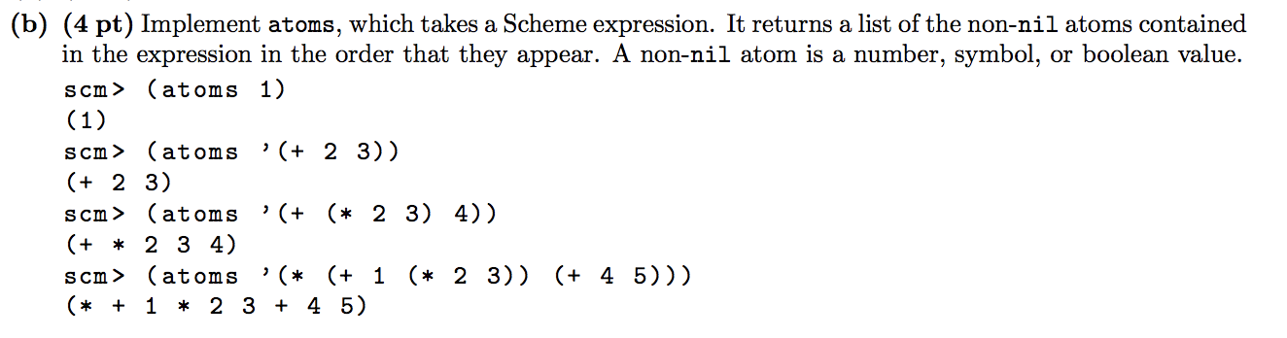
Scheme (Fall 2016 Final Q: 6b)
Hint:
(define (atoms exp)
(cond ((null? exp) ...)
((atom? exp) ...)
(else ...)
)
)
P.S. the function append might be useful (it’s given for a reason!)
Notes:
Note: the hint fades in on click, so the presenter can give students time to first try out the question, then provide a hint a couple of minutes later if needed, and finally reveal the full solution on the next slide.

Slide 21
Scheme (Fall 2016 Final Q: 6b)
Solution:
(define (atoms exp)
(cond ((null? exp) nil)
((atom? exp) (list exp))
(else (append (atoms (car exp))
(atoms (cdr exp))))))

Slide 22
Tail Recursion
Recursion in a tail context; the result of the recursive call is directly returned without being modified
Can use a helper function with additional arguments to “save state”
Scheme can throw away a frame after it makes the recursive call
This prevents “iterative” recursion from taking up too much memory

Slide 23
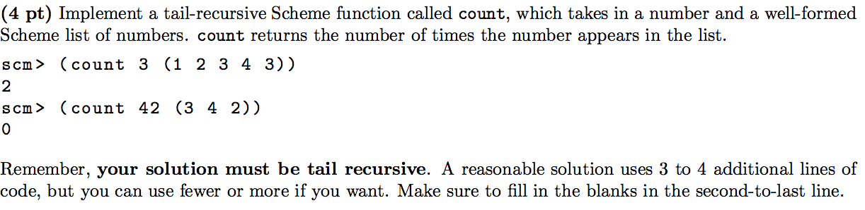
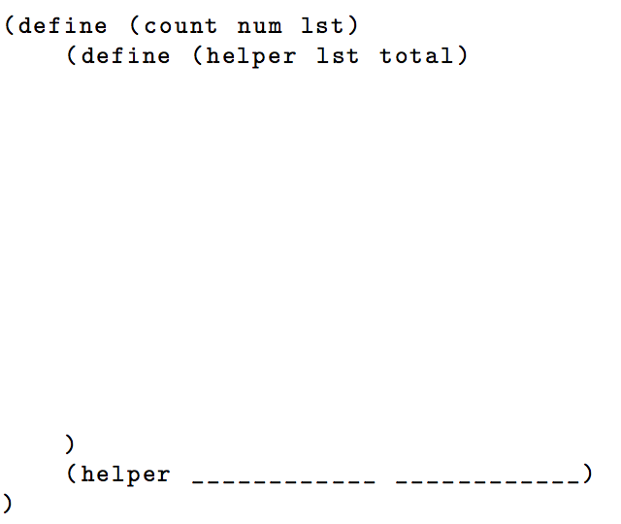
Scheme (Summer 2015 Final Q: 7a)
Notes:
https://61a-su15-website.github.io/assets/pdfs/61a-su15-final.pdf

Slide 24
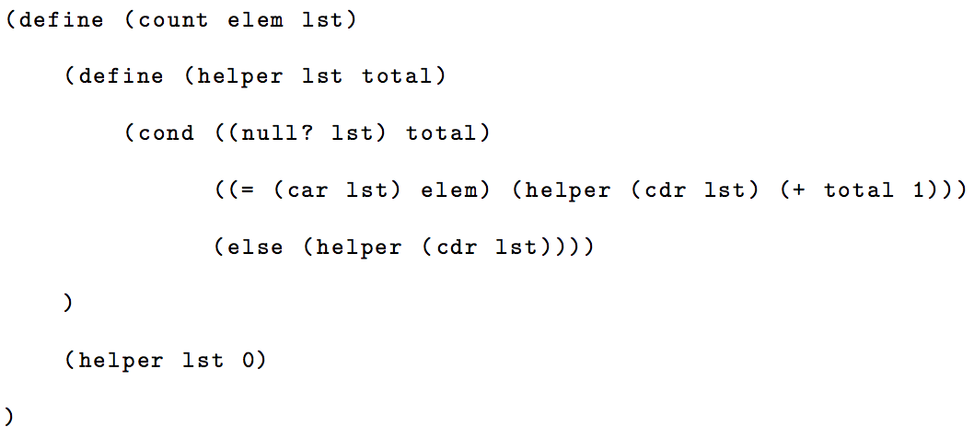
Scheme (Summer 2015 Final Q: 7a)
total)))
Notes:
https://61a-su15-website.github.io/assets/pdfs/61a-su15-final-sol.pdf

Slide 25
Iterators & Generators

Slide 26
Iterators/Generators
An iterable
is an object that has an __iter__ method which returns an iterator.
An iterator
is an object that can be iterated over using its __next__ method.
must implement both __next__ and __iter__
Useful analogy: a book is an iterable; a bookmark is an iterator.
A generator is
an iterator returned by a generator function
a call to __next__ on a generator executes the function’s body until it reaches the yield and then pauses there until the next call.
A generator function is
a function that contains a yield statement to return a value

Slide 27
Iterators/Generators
class StrangeIterator:
def __init__(self):
""" YOUR CODE HERE """
def __next__(self):
""" YOUR CODE HERE """
def __iter__(self):
""" YOUR CODE HERE """
>>> strange_obj = StrangeIterable()
>>> elems = []
>>> for i in strange_obj:
... elems.append(i)
>>> elems
[1, 3, 6, 10, 15, 21, 28, 36, 45]
class StrangeIterable:
def __init__(self):
pass
def __iter__(self):
""" YOUR CODE HERE """
Any iterable object must have a __iter__ that returns an iterator which must have a __next__.

Slide 28
Iterators/Generators
class StrangeIterator:
def __init__(self):
self.start = 0
self.step = 1
def __next__(self):
if self.step >= 10:
raise StopIteration
self.start += self.step
self.step += 1
return self.start
def __iter__(self):
return self
class StrangeIterable:
def __init__(self):
pass
def __iter__(self):
return StrangeIterator()

Slide 29
Iterators/Generators
def mystery_gen():
"""
>>> mg = mystery_gen()
>>> next(mg)
[1]
>>> next(mg)
[2, 2]
>>> next(mg)
[4, 4, 4, 4]
>>> next(mg)
[8, 8, 8, 8, 8, 8, 8, 8]
>>> next(mg)
Traceback (most recent call last):
…
StopIteration
"""

Slide 30
Iterators/Generators
def mystery_gen():
n_of_n = [1]
while n_of_n[0] < 9:
yield n_of_n
next_n = n_of_n[0] * 2
n_of_n = [next_n] * next_n

Slide 31
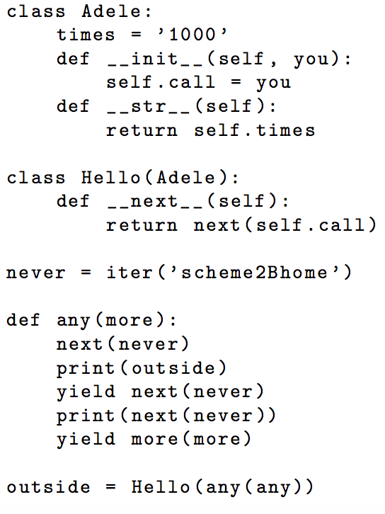
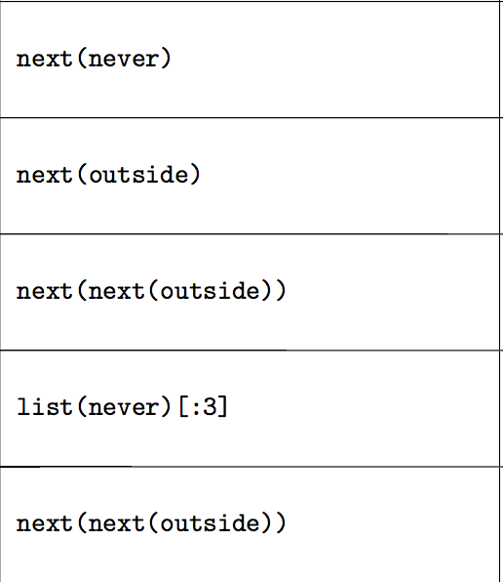
Iterators/Generators (Fa ‘15 Q: 1)
Notes:
http://pythontutor.com/composingprograms.html#code=class+Adele%3A%0A++++times+%3D+'1000'%0A++++def++__init__(self+,+you%29%3A%0A++++++++self.call+%3D+you%0A++++def++__str__(self%29%3A%0A++++++++return++self.times%0Aclass++Hello(Adele%29%3A%0A++++def++__next__(self%29%3A%0A++++++++return++next(self.call%29%0A%0Anever+%3D+iter('scheme2Bhome'%29%0A%0Adef+any(more%29%3A%0A++++next(never%29%0A++++print(outside%29%0A++++yield+next(never%29%0A++++print(next(never%29%29%0A++++yield++more(more%29%0A++++%0Aoutside+%3D+Hello(any(any%29%29&mode=display&origin=composingprograms.js&cumulative=true&py=3&rawInputLstJSON=%5B%5D&curInstr=0

Slide 32
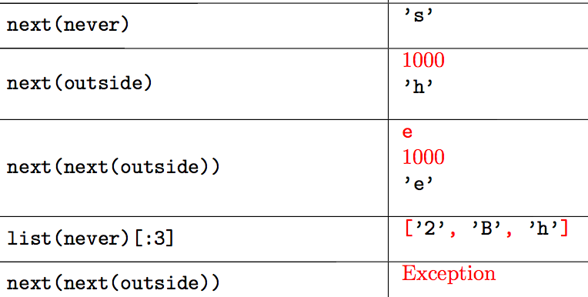
Iterators/Generators (Fa ‘15 Q: 1)
Notes:
http://inst.eecs.berkeley.edu/~cs61a/fa15/assets/pdfs/61a-fa15-final-solution.pdf

Slide 33
Streams & Macros

Slide 34
Final Exam Format (Example)
Final: 7 Questions, 3 Hours
Midterms: 5 Questions, 2 Hours
WWPD
Environment Diagram
SQL
Scheme
Tree Recursion
Multiple Choice Runtime Analysis
Python Mutation
Generators
Final will be cumulative, covering everything in the course

Slide 35
Streams
How can we represent an infinitely long sequence?
Using defined rules to calculate every element of a given sequence
Fib(0) = 0, Fib(1) = 1
Fib(x) = Fib(x - 1) + Fib(x - 2)
How can we represent infinitely long sequences in Python?
Iterators that implement the defined rules of a given sequence
Scheme has no iterators support

Slide 36
Streams
Example:
natural(n): an infinitely long list of increasing natural numbers starting at x
natural(1) : [1, 2, 3, 4, ….]
natural(1): [1, natural(2)]
Stream: a lazy Scheme list (recursive data structure with two elements)
First element: explicitly calculated/represented
Second element: another stream
Will only be evaluated when asked for

Slide 37
Streams Syntax
Generalizing naturals(n):
naturals(1): [1, 2, 3, 4 …] = [1, naturals(2)]
naturals(n): [n, n+1, n+2 … ] = [n, naturals(n+1)]
(define (naturals n) (cons-stream n (naturals (+ n 1)))
(cons-stream operand1 operand2)
Makes a stream [operand1 (element), operand2 (stream)]

Slide 38
Streams Syntax
(define (naturals n) (cons-stream n (naturals (+ n 1)))
(car (naturals 1))
1
(car (cdr-stream (naturals 1)))
2
(naturals 1)
(1 . #[promise (not forced)])

Slide 39
Streams Syntax
Lazy Evaluation
A promise is not evaluated until it is forced
The next element of the stream is not calculated until it is asked for
Memoization
A promise that has been forced will not be re-evaluated
When an element of the stream has been calculated
It is simply stored and returned when asked for again

Slide 40
Example stream problem
Write a function that takes x_0, a, c, and m that implements the following sequence as a Scheme stream:
(define (rng x_0 a c m)
'your-code-here
)

Slide 41
Example stream problem
(define (rng x_0 a c m)
(rng (modulo (+ (* a x_0) c) m)
a c m)
))

Slide 42
Example stream problem (LCG)
(define (rng x_0 a c m)
(cons-stream x_0
(rng (modulo (+ (* a x_0) c) m)
a c m)
))

Slide 43
Streams
Write a procedure combine-streams that takes in two (infinite) streams s1, s2, and a two-argument function combiner returns a new stream that is the result of adding elements from s1 by elements from s2. For instance, if s1 was (1 2 3 ...), s2 was (2 4 6 ...), and combiner was (lambda (x y) (* x y)) then the output would be the stream (2 8 18 ...).
(define (combine-streams s1 s2 combiner)
‘YOUR-CODE-HERE
)

Slide 44
Streams
(define (combine_streams s1 s2 combiner)
(cons-stream (combiner (car s1) (car s2))
(combine_streams (cdr-stream s1)
(cdr-stream s2)
combiner)
)
)

Slide 45
Streams
Write a procedure loopify that takes as input a list and returns an infinite stream with that list infinitely repeated. For example, if list were ‘(1 2 3), loopify would return a stream
(1 2 3 1 2 3 1 2 3 …)
(define (loopify x)
‘YOUR-CODE-HERE
)

Slide 46
Streams
(define (loopify list)
(helper list list)
)
(define (helper cursor first)
(if (null? cursor)
(loopify first)
(cons-stream (car cursor)
(helper (cdr cursor) first)
)))
Why did we need a helper function?
Because the loopify stream has state: it’s not just applying a function over and over again (tail calls); as it moves through the list, it has to remember where it began.
Notice that helper always gets the same value in first.

Slide 47
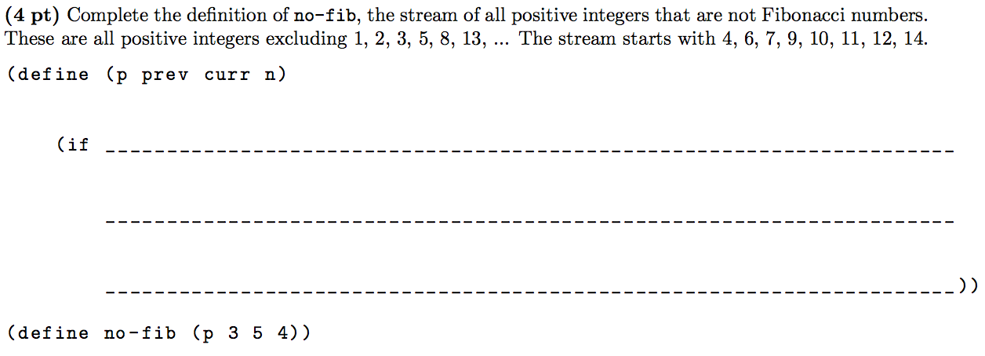
Streams (Fall 2015 Final Q: 7a)
Notes:
http://inst.eecs.berkeley.edu/~cs61a/fa15/assets/pdfs/61a-fa15-final.pdf

Slide 48
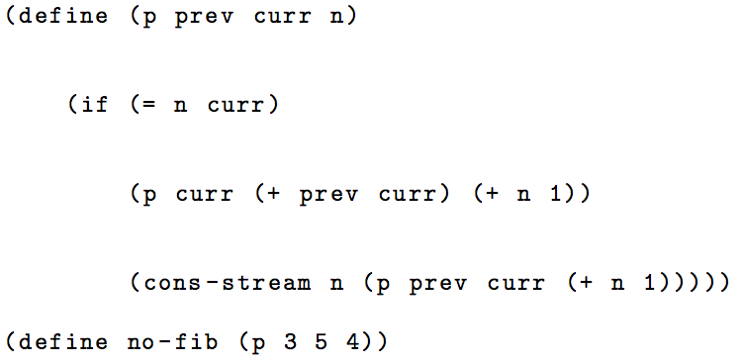
Streams (Fall 2015 Final Q: 7a)
Notes:
http://inst.eecs.berkeley.edu/~cs61a/fa15/assets/pdfs/61a-fa15-final-solution.pdf
(download '75f2dfe0789ee86418bedde8f552a147)

Slide 49
Macros
Short for “macro instructions”
Allows user-defined shorthands that alter the control flow of the program
Examples: infix arithmetic, for loops
Approach: build a “string” representation of code to be executed
Syntax: (define-macro (name operand1 operand2 …) body)
Evaluation:
1. Evaluate operator (to see that we have a macro form)
2. Apply operator to unevaluated operands (quote operands)
3. Evaluate returned expression in frame macro was called in

Slide 50
Macros
Problem: Want a macro that, given an expression called “f”, executes “f” twice.
Approach: build a “string” representation of code to be executed
Given expression “f”, code to be executed: (begin f f)
(begin f f) is a list
First element: the word/string literal “begin”
Second & third elements: the expression referred to by “f”
Not the string “f” literally

Slide 51
Build the list: (begin <f> <f>)
Approach 1: Evaluate everything except the word “begin”, then put into a list
Put [‘begin] [f] [f] into a list
Solution 1: (list ‘begin f f)
Approach 2: Do not evaluate anything except “f” “f”, then put into a list
`(begin ,f ,f)
Quasi-quoting: ` states “do not evaluate anything except those with ,”
, states “evaluate the following expression”
‘ states “do not evaluate anything in the following expression”

Slide 52
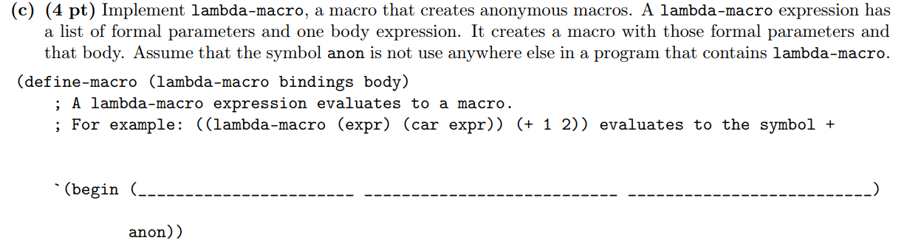

Slide 53
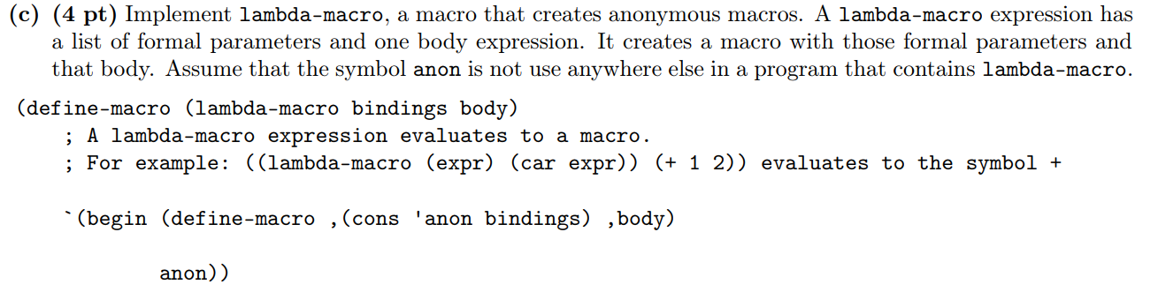

Slide 54
Tree Recursion &
Trees

Slide 55
Recursion Checklist
Base Case
Break the input into smaller size
x - 1, x // 2, x[1:], etc.
Respect the abstraction barrier
Trust the recursive leap of faith
Simply assume the recursive call on smaller input size works

Slide 56
Tree Recursion
!= Trees
Recursion:
Solving an instance of a problem...
...using smaller instances of the same problem
Tree Recursion:
Solving an instance of a problem...
...using more than 1 smaller instances of the same problem
Often used for enumeration
i.e. Exploring all possible ways to do something
Trees: an abstract data type representing hierarchical relationships
Multiple children/paths to explore, tree recursion useful for trees

Slide 57
Trees: Insert Everywhere
Define insert_everywhere, a function that will add a node with the given value as a child of every internal (non-leaf) node of a tree.
def insert_everywhere(t, val):
5
insert_everywhere(t, 1)
5
6
7
6
7
1
4
3
2
4
1
3
2
1

Slide 58
Trees: Insert Everywhere
Complete the implementation below.
def insert_everywhere(t, val):
if not t.branches: # t is a leaf
return
for child in t.branches:
insert_everywhere(child, val)
________________________________________________________

Slide 59
Trees: Insert Everywhere
Complete the implementation below.
def insert_everywhere(t, val):
if not t.branches:
return
for child in t.branches:
insert_everywhere(child, val)
t.branches.append(Tree(val))

Slide 60
Trees: Greater Than
Write a function that compares two trees of identical structure, returning the number of nodes from t1 that have larger entries than the corresponding nodes in t2.
def tree_greater_than(t1, t2):
t1
t2
3
5
t1 > t2 = 3
2
7
6
4
5
4
6
1
5
2

Slide 61
Trees: Greater Than Solution
def tree_greater_than(t1, t2):
if t1.entry > t2.entry:
count = 1
else:
count = 0
for i in range(len(t1.branches)):
count += tree_greater_than(t1.branches[i],
t2.branches[i])
return count

Slide 62
Binary Trees
A tree is a binary tree if each node has exactly 2 children.
A binary tree is a binary search tree if
Its value is greater than those of all nodes on its left.
Its value is less than those of all nodes on its right.
To search a BST, take branches by comparing to the root value.
“bushy” trees (more children) are usually faster to search.

Slide 63
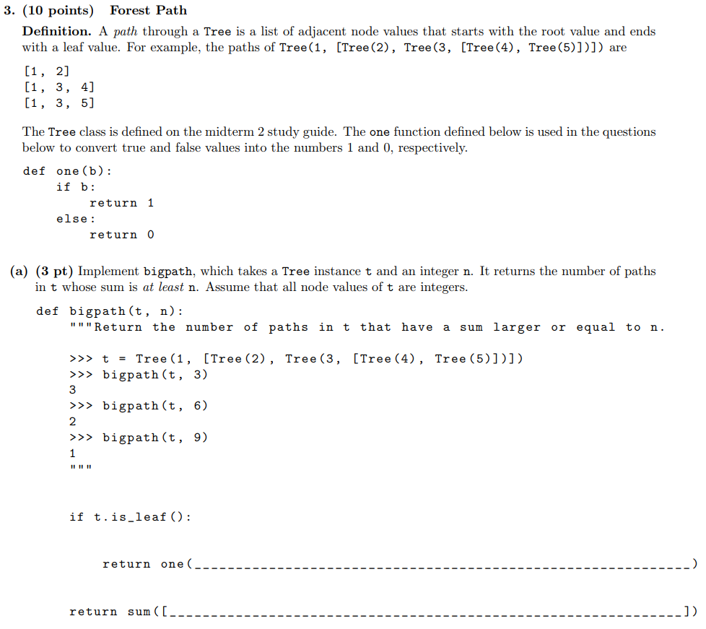

Slide 64
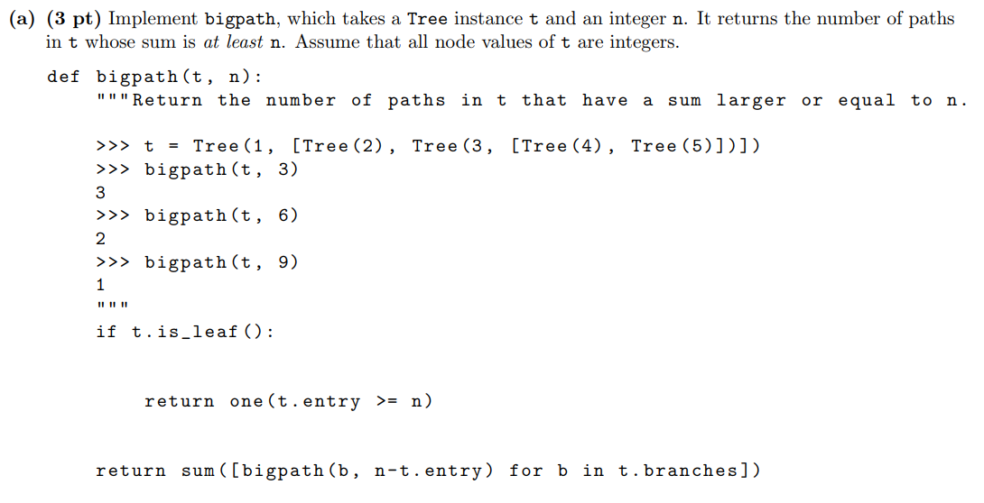

Slide 65
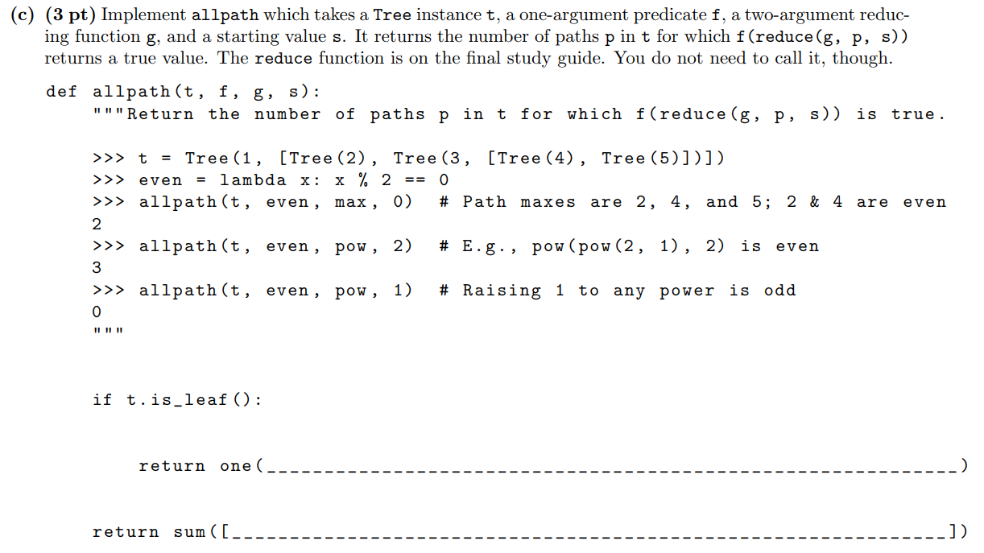

Slide 66
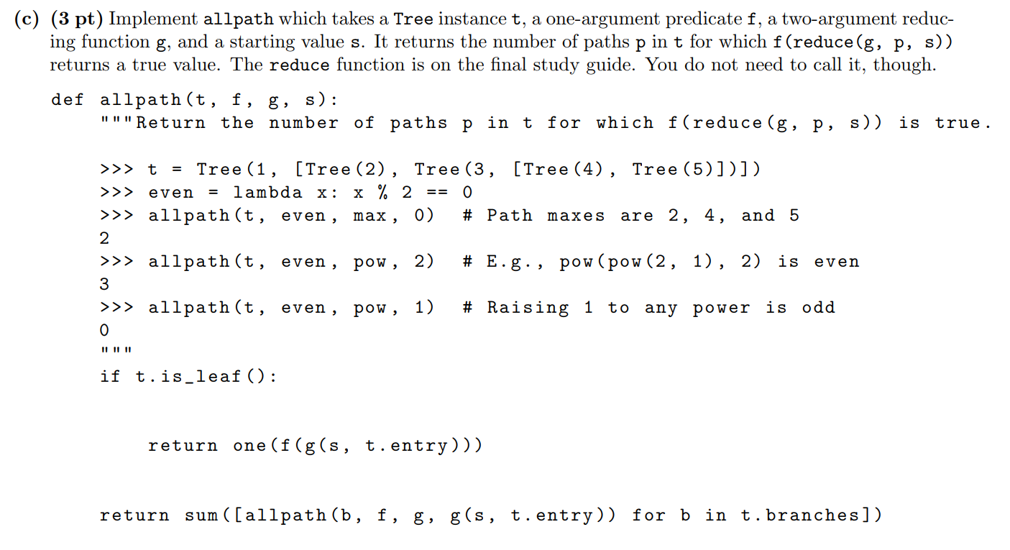

Slide 67
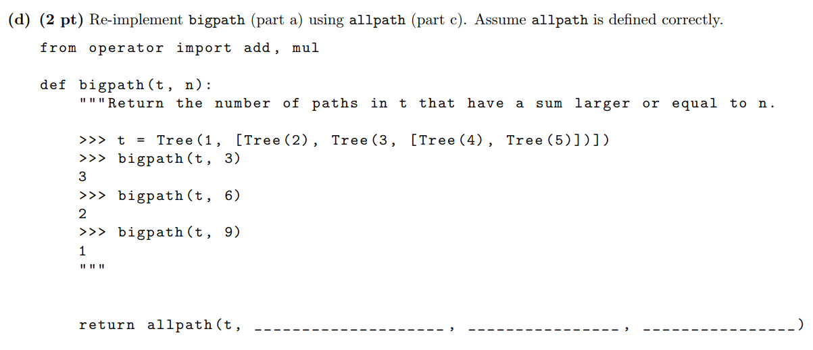

Slide 68
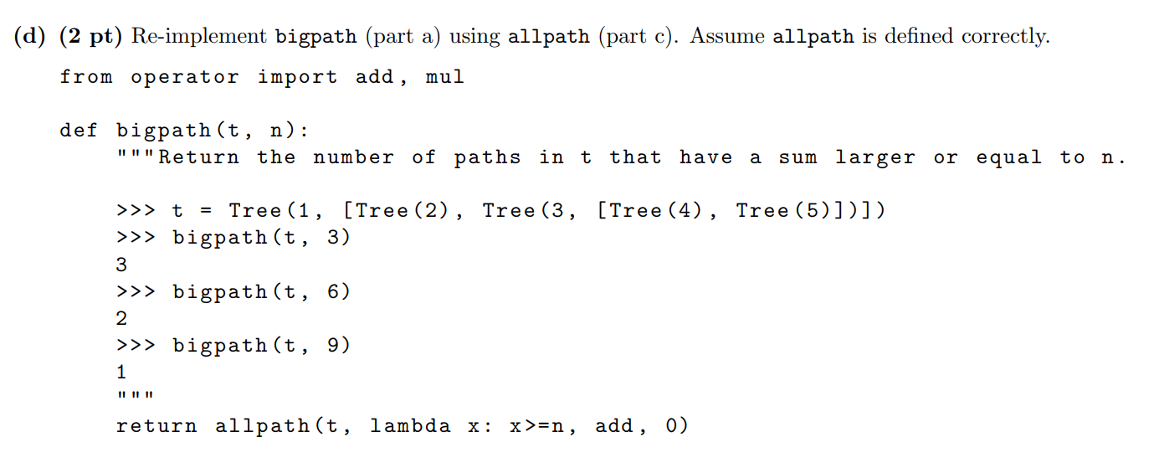

Slide 69
Lists &
Linked Lists

Slide 70
Lists
Before: primitive, atomic values -> 1, “Hello World”, etc.
Now: data structure storing multiple elements in a sequence
Python Lists:
L = [1, 2, 3]
Accessing elements: indexing
0-indexed: L[0] => 1
Nested lists: lst = [1, 2, [3, [4]]]
Box-and-Pointer Diagrams
List comprehension: [ <expr> for <name> in <sequence> if <cond> ]

Slide 71
List Mutation
J = L + K
Makes a new list J that is the elements of L, then elements of K
L.append(x)
Adds x as the last element of L
L.extend(x)
Adds the elements of x as the last elements of L
L += x

Slide 72
List Mutation
L.insert(i, el):
Inserts element el at index i in L
L.remove(el):
Removes first occurence of element el in L
L.pop(i):
Removes and returns the element at index i

Slide 73
List Mutation
L is K
Returns True if L and K are the exact same list object
L == K
Returns True if L and K are lists that have the same elements in order
L[i:j]
Splice; returns copy of L from element i to j-1
L[:]
Returns copy of L

Slide 74
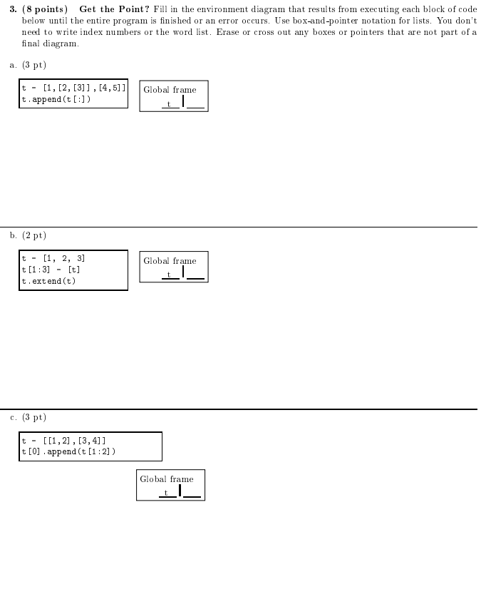

Slide 75
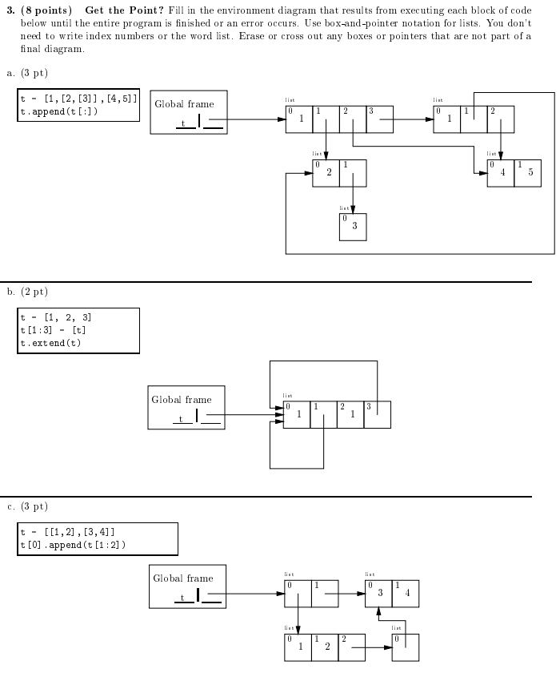

Slide 80
Linked Lists
class Link: empty = () def __init__(self, first, rest=empty): self.first = first self.rest = rest def __len__(self): return 1 + len(self.rest)
def __repr__(self):
return "Link({}, {})".format(self.first, self.rest)

Slide 81
Linked Lists: Swap Pairs
Write the function swap_pairs which will take in a linked list and swap every pair of entries. (Assume there are an even number of entries.)
def swap_pairs(lst):
"""
>>> a = Link(2, Link(1, Link(4, Link(3, Link(6, Link(5))))))
>>> swap_pairs(a)
>>> a
Link(1, Link(2, Link(3, Link(4, Link(5, Link(6, ()))))))
"""

Slide 82
Linked Lists
def swap_pairs(lst):
if lst != Link.empty:
lst.first, lst.rest.first = lst.rest.first, lst.first
swap_pairs(lst.rest.rest)

Slide 83
Linked Lists: Double Double
def double_double(lst):
"""
>>> a = Link(1, Link(2, Link(3)))
>>> double_double(a)
>>> a
Link(2, Link(2, Link(4, Link(4, Link(6, Link(6, ()))))))
"""

Slide 84
Linked Lists: Double Double
Fill in the blank
def double_double(lst):
if lst != Link.empty:
lst.first = ________
double_double(________)
lst.rest = Link(_________, lst.rest)

Slide 85
Linked Lists: Double Double
def double_double(lst):
if lst != Link.empty:
lst.first = 2*lst.first
double_double(lst.rest)
lst.rest = Link(lst.first, lst.rest)

Slide 86
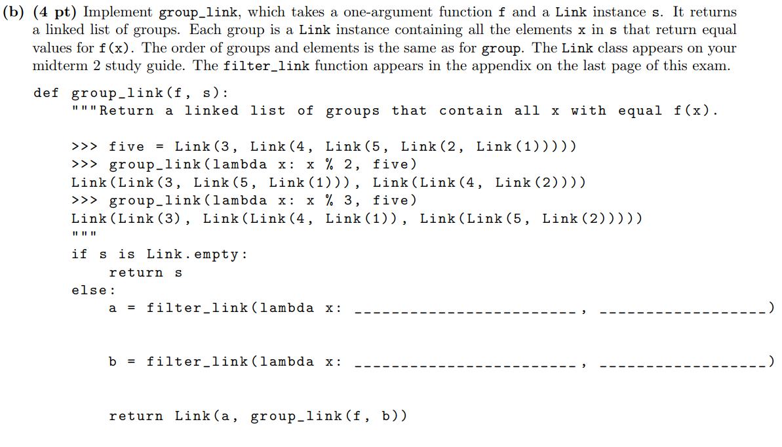

Slide 87
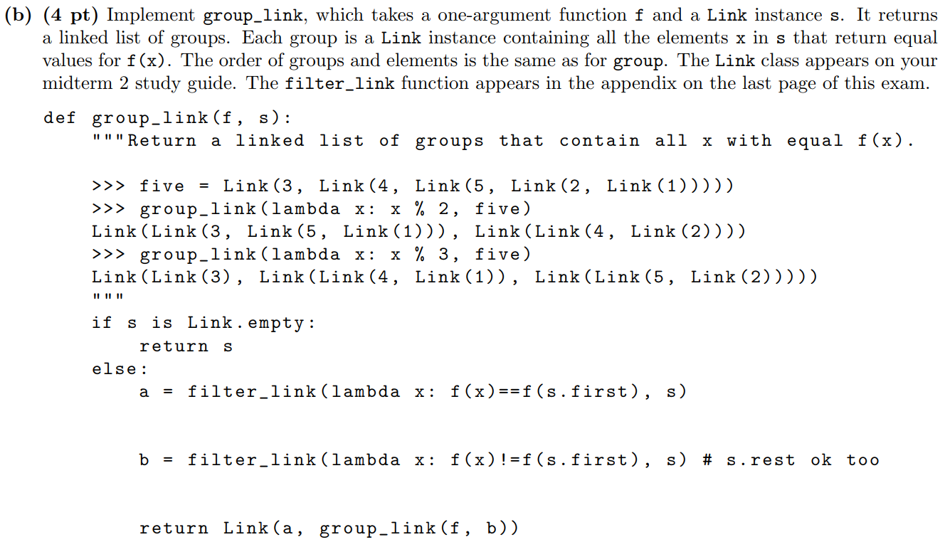

Slide 88
Break!
Please fill out this feedback form:
hkn.mu/feedback

Slide 89
Orders of Growth

Slide 90
Orders of Growth
As users of computer programs, we care about how fast they run and how much space on our computer they use.
“Orders of Growth” is an important and common way of classifying this.
For running time, Big Θ notation is used to classify algorithms by how long it takes them to finish with respect to (as a function of) the size of the input.
For space, we use the same system, but we care about the maximum amount of space the function uses at any point in time.
Sometimes, this is called time complexity or space complexity.

Slide 91
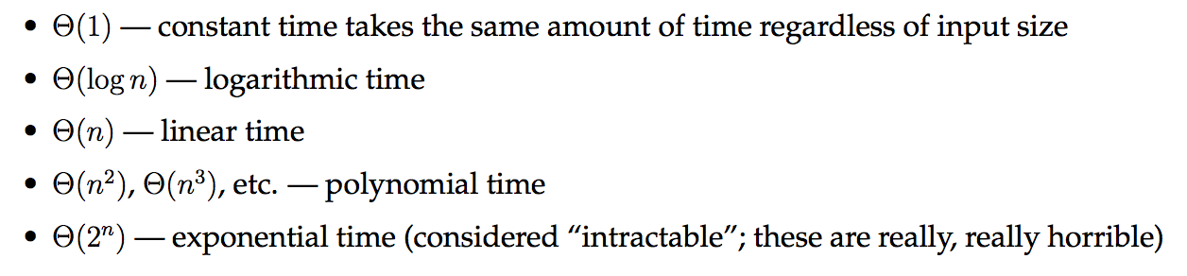
Orders of Growth
Various runtimes

Slide 92
Orders of Growth - Tips
Tally up all of the total time/space of each function first, then reduce later.
Remember to drop coefficients. Θ(10000n^2) → Θ(n^2)
We only care about the largest (worst) part of our Θ(), so drop any smaller terms if they are added on.
Ex. Θ(n log n + log n) → Θ(n log n) Θ(3^n + 4^n + n^5) → Θ(4^n)
DRAW DIAGRAMS!!!!!
Always remember: you are finding the time/space in terms of the input size, which is some variable(s) given in the problem.

Slide 93
Orders of Growth - Advanced
When two nested loops don’t mess with each other, multiply their individual runtimes. (BE CAREFUL!)
How to recognize a log(n) function: If you multiply the input size by a constant, then a constant gets added to the time/space.
Think about data structures: Appending to the beginning of a linked list (length n) is Θ(1). Appending to the end is Θ(n). Can you see why?
DRAW DIAGRAMS!!!!!

Slide 94
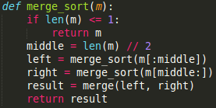
Orders of Growth - Merge Sort
Given: merge(a, b) takes Θ(m + n) time, where len(a) = m and len(b) = n
Consider: Draw a tree and figure out the runtime at each step.

Slide 95
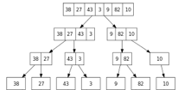
Orders of Growth - Merge Sort Soln.
Height: θ(log n)
θ(n)
θ(n)
θ(n)
θ(n)
Solution Strategy: Draw tree, count total time on each level. Each call to merge takes θ(n) time. We call merge once on an input of size n, twice on an input of size n/2 (left and right), four times on an input of size n/4, and so on. This means that we do θ(n) work at each level. There are log n of these layers, so the total runtime is θ(n log n).

Slide 96
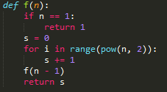
Orders of Growth - Another Example
Consider: Draw a diagram and figure out the runtime at each step.

Slide 97
Orders of Growth - Another Ex. Soln.
n
n-1
1
θ(n^2)
θ((n-1)^2)
θ((n-2)^2)
θ(1^2)
Each call to f(n) takes n^2 time, due to the for loop.
f gets recursively called n times, and each time it does approx. n^2 work.
Therefore, our final runtime is θ(n^2 * n) = θ(n^3).

Slide 98
Object-Oriented Programming

Slide 99
Object Oriented Programming
Objects have State and Behavior
Classes “blueprint” Objects, which are instanced.
A bound method is a function in a class which is called using dot notation from an instance of a class.
Bound Methods have their first argument automatically bound to the instance which called them.
Notes:
http://cs61a.org/assets/slides/14_6pp.pdf
http://cs61a.org/assets/slides/15_6pp.pdf
http://composingprograms.com/pages/25-object-oriented-programming.html
http://cs61a.org/lab/lab06/

Slide 100
OOP
Class Variable
Shared across all instances of a class, and the class “blueprint” itself.
Must be referenced from a class or instance, like using self.x
Instance Variable
Specific information per instance
Must be referenced from an instance, like using self.x
When looking up a variable of an instance, check
instance variables first,
then class variables,
then parent class variables.
Notes:
http://cs61a.org/lab/lab06/

Slide 101
Representation
__init__(self, *args)
“Constructor” of the class
Called implicitly when object is made (e.g. dog = Dog(“fido”))
__repr__(self)
Returns a Python-readable representation of an object
Called implicitly when repr function used (e.g. repr(dog))
How you would reproduce the object in Python
__str__(self)
Returns a human-readable representation of an object
Called implicitly when object is printed
Can be called using str function

Slide 102
Representation Examples
class Dog(object):
def __init__(self, name):
self.name = name
def __str__(self):
return self.name + ‘ the doggo’
def __repr__(self):
const = ‘Dog(\’’
End = ‘\’)’
return const + self.name + end
>>> dog = Dog(‘Gabe’)
>>> print(dog)
???
>>> dog
???
>>> repr(dog)
???
>>> eval(repr(dog)).name == dog.name
???
>>> print(Dog.str(dog))
???
>>> print(Dog.__repr__(dog))
???
>>> Dog.__str__(dog)
???
>>> Dog.__str__
???

Slide 103
Representation Examples
class Dog(object):
def __init__(self, name):
self.name = name
def __str__(self):
return self.name + ‘ the doggo’
def __repr__(self):
const = ‘Dog(\’’
End = ‘\’)’
return const + self.name + end
>>> dog = Dog(‘Gabe’)
>>> print(dog)
Gabe the doggo
>>> dog
Dog(‘Gabe’)
>>> repr(dog)
‘Dog(‘Gabe’)’
>>> eval(repr(dog)).name == dog.name
True
>>> print(Dog.str(dog))
Error
>>> print(Dog.__repr__(dog))
Dog(‘Gabe’)
>>> Dog.__str__(dog)
‘Gabe the doggo’
>>> Dog.__str__
Function ...
Notes:
Dog.str doesnt work because call should be Dog.__str__(dog)

Slide 104
OOP: What would Python print?
class Plant(object):
color = 'green'
def __init__(self, color):
self.color = color
self.seeds = 0
def fruit(self):
self.seeds += 1
class BlueBerry(Plant):
def __init__(self):
Plant.__init__(self, 'blue')
def fruit(self):
self.seeds += 5
>>> Plant.color
???
>>> Plant.seeds
???
>>> BlueBerry.seeds
???
>>> b = BlueBerry()
>>> b.color
???
>>> BlueBerry.color
???
>>> b.seeds
???
>>> b.fruit()
>>> b.seeds
???
Notes:
http://pythontutor.com/composingprograms.html#code=class+Plant(object%29%3A%0A++++color+%3D+'green'%0A++++def+__init__(self,+color%29%3A%0A++++++++self.color+%3D+color%0A++++++++self.seeds+%3D+0%0A%0A++++def+fruit(self%29%3A%0A++++++++self.seeds+%2B%3D+1%0A%0Aclass+BlueBerry(Plant%29%3A%0A++++def+__init__(self%29%3A%0A++++++++Plant.__init__(self,+'blue'%29%0A%0A++++def+fruit(self%29%3A%0A++++++++self.seeds+%2B%3D+5%0A%0Aprint(Plant.color%29%0Aprint(Plant.seeds%29%0Aprint(BlueBerry.seeds%29%0A%0Ab+%3D+BlueBerry(%29%0Aprint(b.color%29%0Aprint(BlueBerry.color%29%0Aprint(b.seeds%29%0A%0Ab.fruit(%29%0Aprint(b.seeds%29%0A&mode=display&origin=composingprograms.js&cumulative=true&py=3&rawInputLstJSON=%5B%5D&curInstr=0

Slide 105
OOP: What would Python print?
class Plant(object):
color = 'green'
def __init__(self, color):
self.color = color
self.seeds = 0
def fruit(self):
self.seeds += 1
class BlueBerry(Plant):
def __init__(self):
Plant.__init__(self, 'blue')
def fruit(self):
self.seeds += 5
>>> Plant.color
‘green’
>>> Plant.seeds
AttributeError
>>> BlueBerry.seeds
AttributeError
>>> b = BlueBerry()
>>> b.color
‘blue’
>>> BlueBerry.color
‘green’
>>> b.seeds
0
>>> b.fruit()
>>> b.seeds
5
Notes:
http://pythontutor.com/composingprograms.html#code=class+Plant(object%29%3A%0A++++color+%3D+'green'%0A++++def+__init__(self,+color%29%3A%0A++++++++self.color+%3D+color%0A++++++++self.seeds+%3D+0%0A%0A++++def+fruit(self%29%3A%0A++++++++self.seeds+%2B%3D+1%0A%0Aclass+BlueBerry(Plant%29%3A%0A++++def+__init__(self%29%3A%0A++++++++Plant.__init__(self,+'blue'%29%0A%0A++++def+fruit(self%29%3A%0A++++++++self.seeds+%2B%3D+5%0A%0Aprint(Plant.color%29%0Aprint(Plant.seeds%29%0Aprint(BlueBerry.seeds%29%0A%0Ab+%3D+BlueBerry(%29%0Aprint(b.color%29%0Aprint(BlueBerry.color%29%0Aprint(b.seeds%29%0A%0Ab.fruit(%29%0Aprint(b.seeds%29%0A&mode=display&origin=composingprograms.js&cumulative=true&py=3&rawInputLstJSON=%5B%5D&curInstr=0

Slide 106
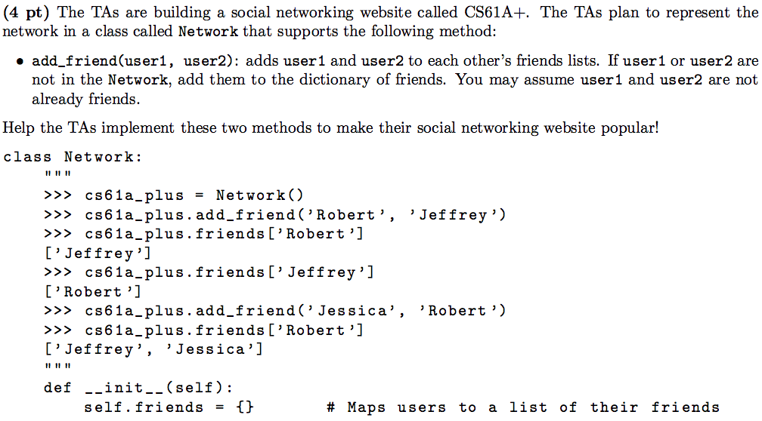
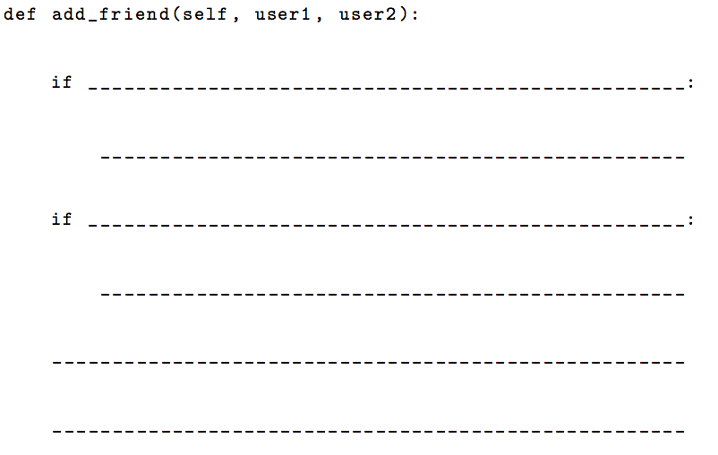
OOP (Summer 2015 Final Q: 5a)
Notes:
https://61a-su15-website.github.io/assets/pdfs/61a-su15-final.pdf

Slide 107
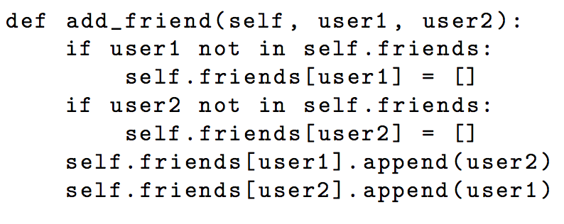
OOP (Summer 2015 Final Q: 5a)
Notes:
https://61a-su15-website.github.io/assets/pdfs/61a-su15-final-sol.pdf

Slide 108
Environment Diagrams

Slide 109
Environment diagrams
Parent of a function is where function was defined
Calling a function? New frame under operator’s parent
Evaluate right, then bind to closest variable (unless nonlocal)
Lambda function? Keep track of line numbers
Notes:
http://cs61a.org/disc/disc02.pdf

Slide 110
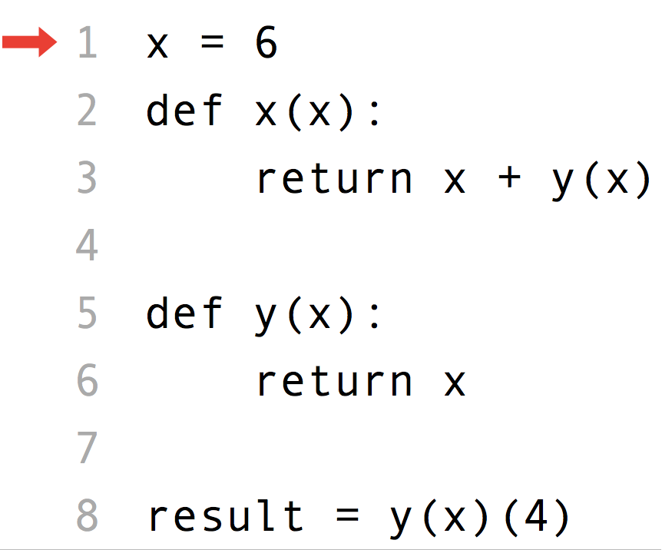
Environment Diagrams
What is result?
How do name conflicts work?
Notes:
http://pythontutor.com/composingprograms.html#code=x+%3D+6%0Adef+x(x%29%3A%0A++++return+x+%2B+y(x%29%0A%0Adef+y(x%29%3A%0A++++return+x%0A%0Aresult+%3D+y(x%29(4%29&mode=display&origin=composingprograms.js&cumulative=true&py=3&rawInputLstJSON=%5B%5D&curInstr=13

Slide 111
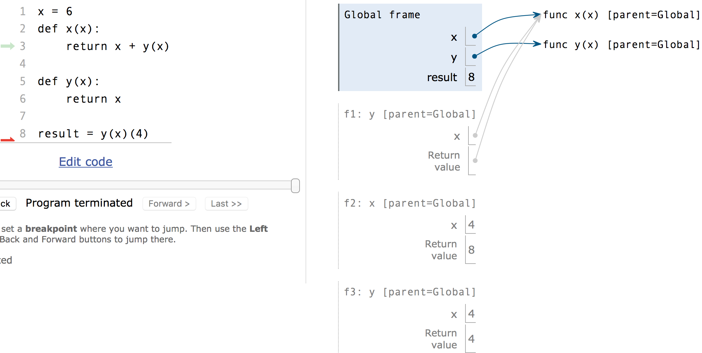
Environment Diagrams

Slide 112
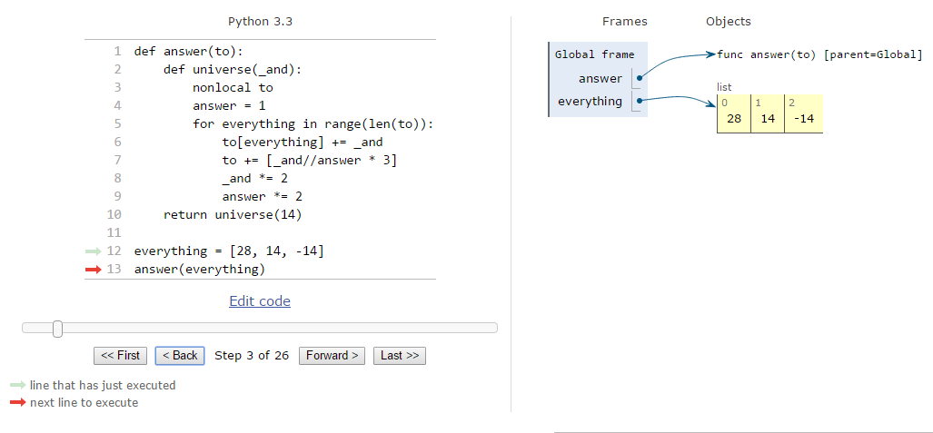
Environment Diagrams
Does len(to) change?
What does += do to lists?
Notes:
http://pythontutor.com/composingprograms.html#code=def+answer(to%29%3A%0A++++def+universe(_and%29%3A%0A++++++++nonlocal+to%0A++++++++answer+%3D+1%0A++++++++for+everything+in+range(len(to%29%29%3A%0A++++++++++++to%5Beverything%5D+%2B%3D+_and%0A++++++++++++to+%2B%3D+%5B_and+//+answer+*+3%5D%0A++++++++++++_and+*%3D+2%0A++++++++++++answer+*%3D+2%0A++++return+universe(14%29%0A%0Aeverything+%3D+%5B28,+14,+-14%5D%0Aanswer(everything%29&mode=display&origin=composingprograms.js&cumulative=true&py=3&rawInputLstJSON=%5B%5D&curInstr=2

Slide 113
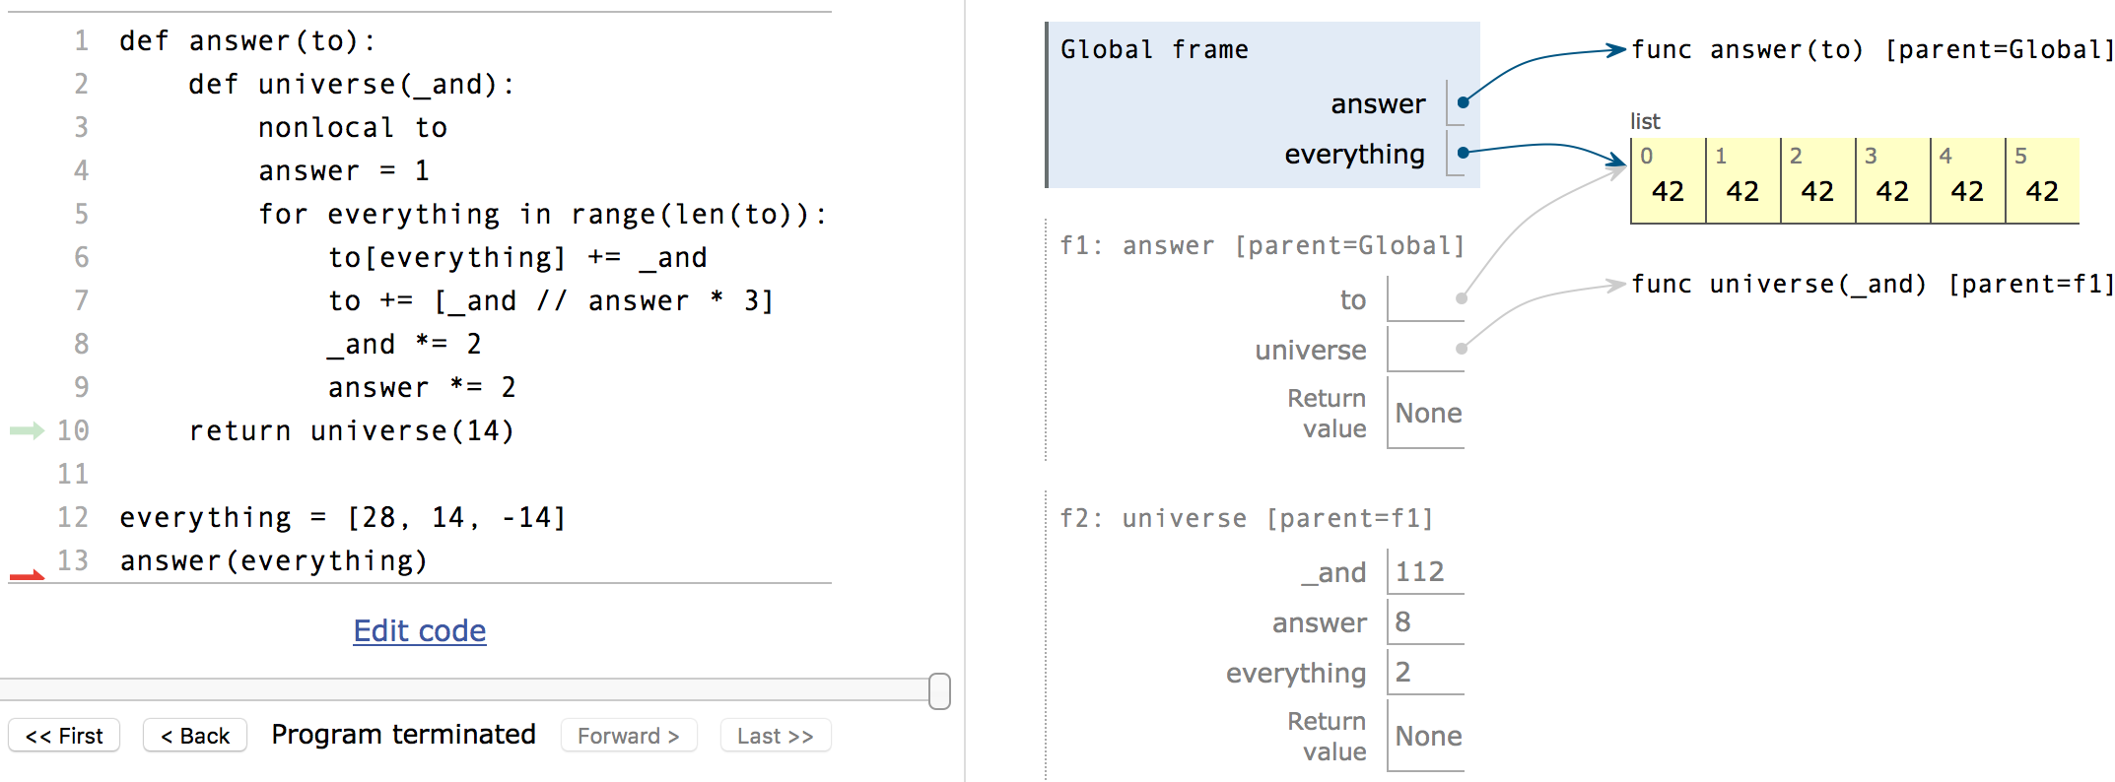
Environment Diagrams

Slide 114
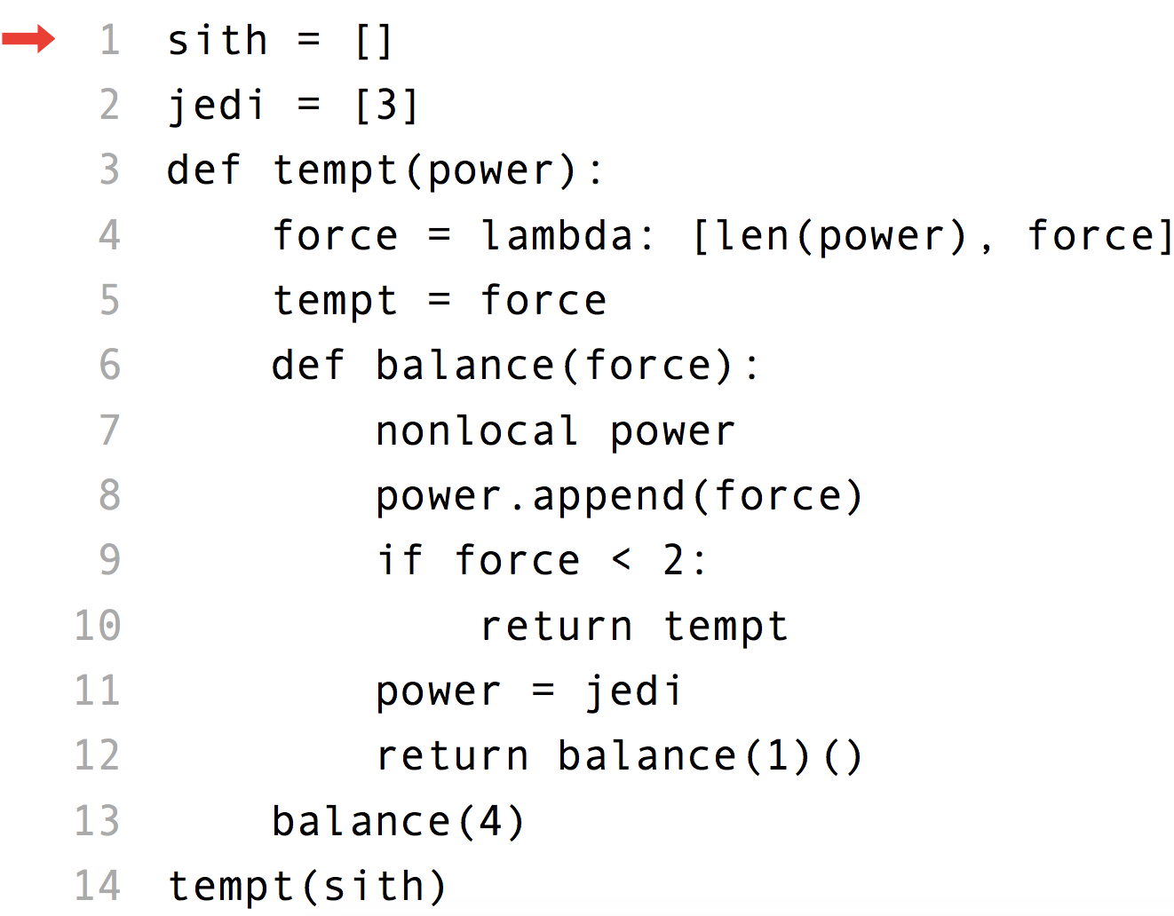
Environment Diagrams (Fa ‘15 Final)
Notes:
http://pythontutor.com/composingprograms.html#code=sith+%3D+%5B%5D+%0Ajedi+%3D+%5B3%5D+%0Adef+tempt(power%29%3A+%0A++++force+%3D+lambda%3A+%5Blen(power%29,+force%5D+%0A++++tempt+%3D+force+%0A++++def+balance(force%29%3A++%0A++++++++nonlocal+power+%0A++++++++power.append(force%29+%0A++++++++if+force+%3C+2%3A+%0A++++++++++++return+tempt+%0A++++++++power+%3D+jedi+%0A++++++++return+balance(1%29(%29+%0A++++balance(4%29+%0Atempt(sith%29&mode=display&origin=composingprograms.js&cumulative=true&py=3&rawInputLstJSON=%5B%5D&curInstr=24

Slide 115
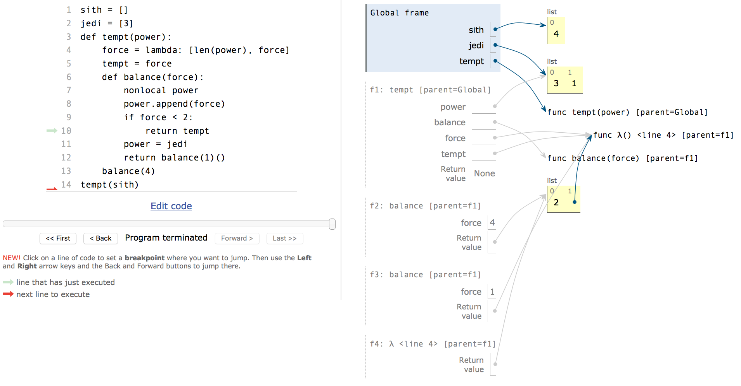
Environment Diagrams (Fa ‘15 Final)

Slide 116
Conclusion
Please fill out the feedback forms to help us improve.
hkn.mu/feedback
Thanks for coming, and best of luck on the final!

Slide 117
SQL (Aggregation)
bears
Create a table above_average that includes the weight and name of every bear that shares the 100's digit of its weight with at least one other bear and has a weight that is at least the average of all bears that have the same 100's digit.
Based off Su17 HW10
name | weight
Oski | 300
Pooh | 350
Yogi | 425
Po | 375
Gummy | 425
Notes:
Answer requires use of “with” clause.

Slide 118
SQL (Aggregation)
Create a table above_average that includes the weight and name of every bear that shares the 100's digit of its weight with at least one other bear and has a weight that is at least the average of all bears that have the same 100's digit.
with averages(digit, mean) AS (
SELECT weight/100, avg(weight) FROM bears GROUP BY weight/100 HAVING count(*)>1
)
SELECT weight, name FROM dogs, averages
WHERE weight >= mean AND digit = weight/100;
Based off Su17 HW10
Notes:
Answer requires use of “with” clause.

Slide 119
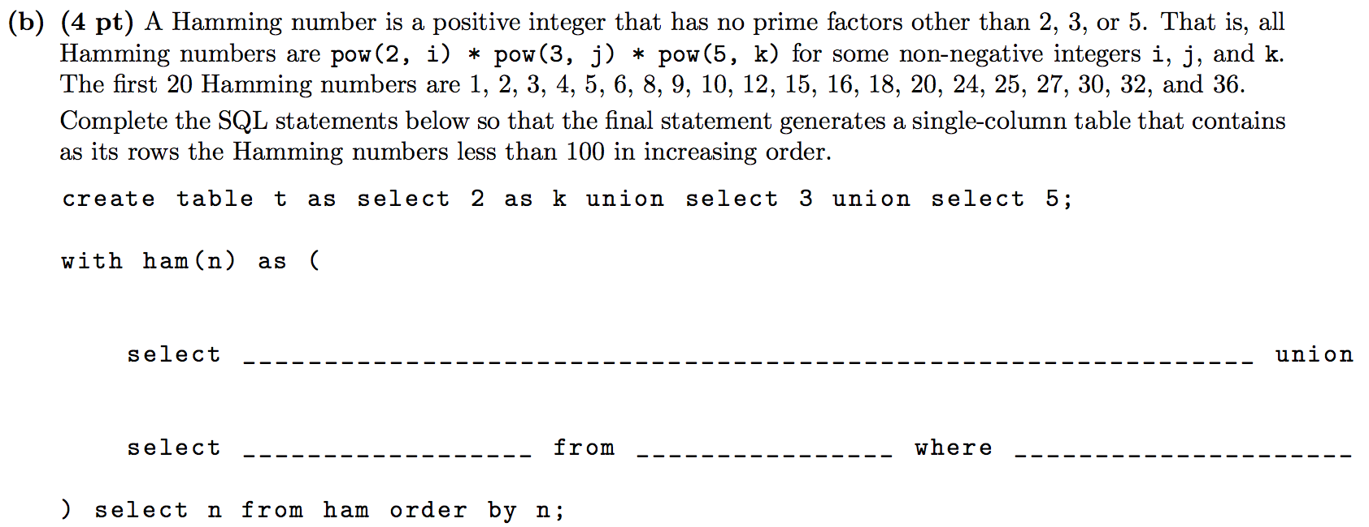
Recursive SQL (Fall 2015 Final 7b)
Notes:
http://inst.eecs.berkeley.edu/~cs61a/fa15/assets/pdfs/61a-fa15-final.pdf

Slide 120
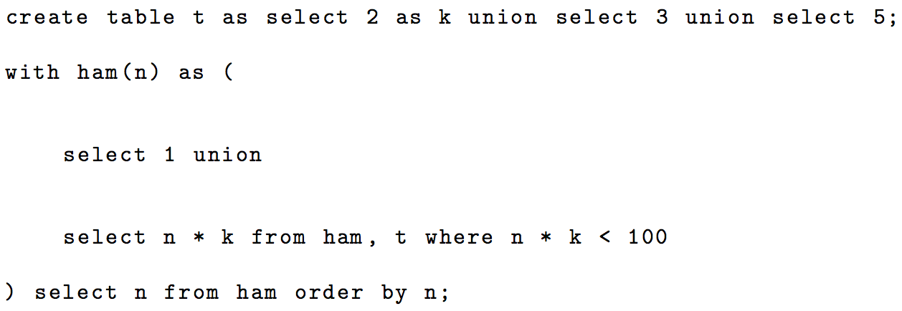
Recursive SQL (Fall 2015 Final 7b)
Notes:
http://inst.eecs.berkeley.edu/~cs61a/fa15/assets/pdfs/61a-fa15-final-solution.pdf

